Slide 1
The Fight for Gay Rights
From Stonewall to Marriage Equality

Slide 2
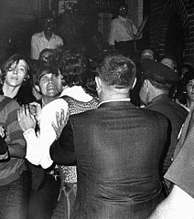
The Stonewall Riots
Violent demonstrations by the gay community against a police raid of the Stonewall Inn in NYC in 1969.
Considered a seminal event in the fight for equal rights for gays and lesbian in the US.

Slide 3

Harvey Milk
Milk was the first openly gay politician in the US
He won a position on the San Francisco Board of Supervisors, elected in 1977.
He was assassinated, along with SF Mayor George Moscone, by fellow supervisor Dan White.
He was awarded Presidential Medal of Freedom, posthumously in 2009.

Slide 4
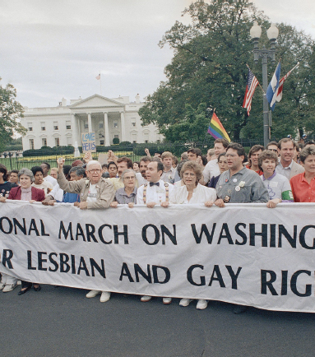
1996 Romer v. Evans
Colorado passed a state amendment prohibiting protections for gays and lesbians.
The State Supreme Court struck down the amendment, saying it was discriminatory.
The US Supreme Court agreed with the Colorado court and ruled in favor of Evans.
It was the first victory for gay and lesbian rights in the US Supreme Court

Slide 5
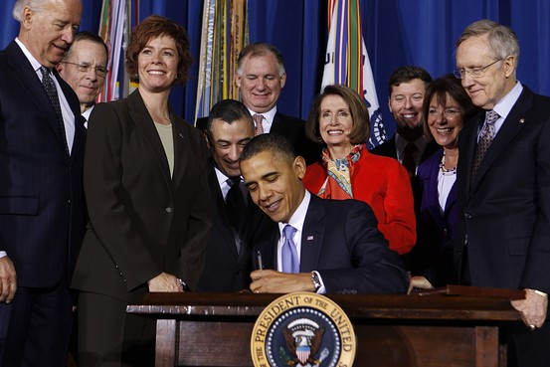
Ending Don’t Ask, Don’t Tell
During the Clinton Administration the policy of “don’t ask don’t tell” was implemented in the US military.
This meant that gay and lesbian military personnel could be discharged for being openly gay.
In 2010 the Congress began the repeal of DADT, and the President signed the repeal in 2011.

Slide 6
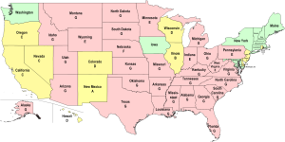
Marriage Equality Map

Slide 7
Marriage Equality
In recent years there has been a political movement to legalize same sex marriages.
Nine states currently recognize same sex couples.
Several states offer civil unions, guaranteeing some of the rights of married heterosexual couples.
However, 31 states have constitutional restrictions limiting marriage to one man and one woman.

Slide 8
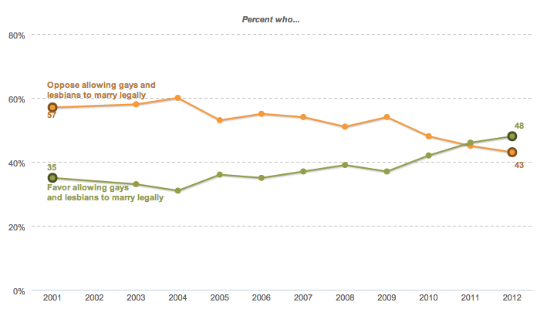
Pew Poll on Same Sex Marriage

Slide 9
A National Issue
The Federal Government passed the Defense of Marriage Act” (DOMA) prohibiting same sex couples from receiving certain federal benefits given to heterosexual married couples.
President Obama has come out in favor of same sex marriage and the Justice Department has refused to enforce DOMA
Recent polls indicate the majority of Americans, especially younger Americans, favor making same sex marriage legal

Slide 10
What do you think?
Should there be a national amendment regarding the definition of marriage, or should it remain the decision of individual states to define marriage?
Should marriage be viewed as a civil rights issue or an issue of religious freedom?
What do you think will be the long run impact of your generation on the issue of same sex marriage and gay rights?

