Slide 1
Government Spending

Slide 2
The Public Sector
The public sector includes local, state, and federal governments
The public sector is supported primarily through tax revenue
The private sector includes the small and large businesses that are privately owned.
Since the Great Depression the public sector has increased in size due primarily to increases in spending on social programs and the military.

Slide 3
Public Sector Goods and Services
The public sector provides a broad variety of goods and services.
Buildings, roads, and bridges are provided by all levels of government.
Firefighters and teachers are public sector workers.
The government has become a large employer for many different types of workers

Slide 4
Transfer Payments
The largest government program in the federal budget is Social Security.
Social Security is a transfer payments.
The government collects employee and employer contributions each month through the FICA payroll tax.
When contributors reach old age, they draw a pension from the Social Security fund.
Depending on how long they live, they may draw out more or less than they contributed.

Slide 5
Mandatory Spending
About two thirds of the federal budget is mandatory spending.
Mandatory spending are items that must be funded, without annual approval from Congress.
These programs include: Social Security, Medicare, and the interest owed on the debt.
In recent decades there has been concern that increases in mandatory spending are eating too much of the federal budget.

Slide 6
Discretionary Spending
About one third of the federal budget is comprised of discretionary spending.
Discretionary spending includes all the programs which Congress may decide to increase or decrease annually.
These programs are numerous and include military spending, as well as health, education, environmental protection etc.

Slide 7
The Budget Process
The fiscal year starts October 1st
The President establishes a general budget for taxes and spending, submitting it Congress in February.
The House of Representatives may change the budget priorities by submitting an appropriations bill.
This bill must be approved by the Senate and signed by the President, as well.

Slide 8
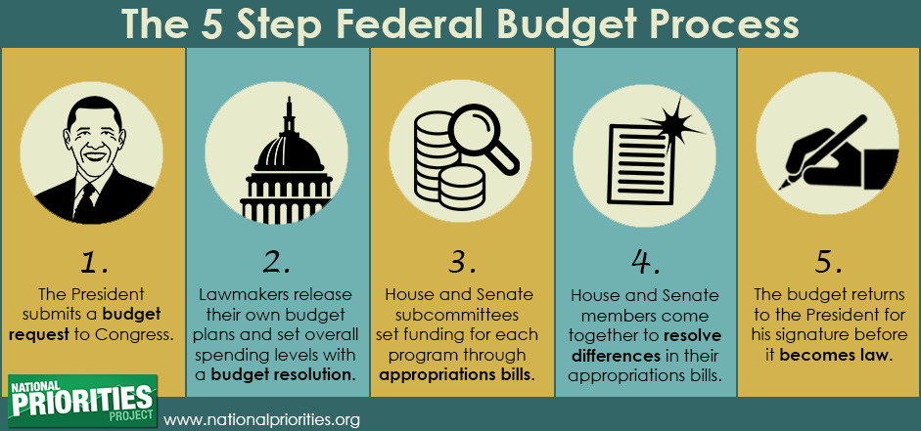

Slide 9
Budget Deficits and Surpluses
The national budget may be balanced, meaning that the tax revenue proposed equals the money spent on government programs.
However, if the budget contains more spending than tax revenues, a budget surplus will occur.
If the budget contains more revenue than spending, it has a surplus.
In the late 1990’s the US ran s surplus, since that time it has had deficits each year.

Slide 10
The National Debt
The budget deficit records shortfall in revenue for a single year.
The National Debt is the accumulation of all deficits.
The US government may borrow money from Americans, banks, or foreign governments to pay for its shortfall.
The government must pay back the interest and the principle borrowed.

Slide 11
Crowding Out Effect
Some economists argue that borrowing is necessary, especially during a recession or depression.
The government can uses borrowed money to spend, getting people back to work.
Other economists warn that government borrowing crowds out private borrowing, leading to higher interest rates.
Higher interest rates make it difficult for private citizens and businesses to borrow

