Slide 1
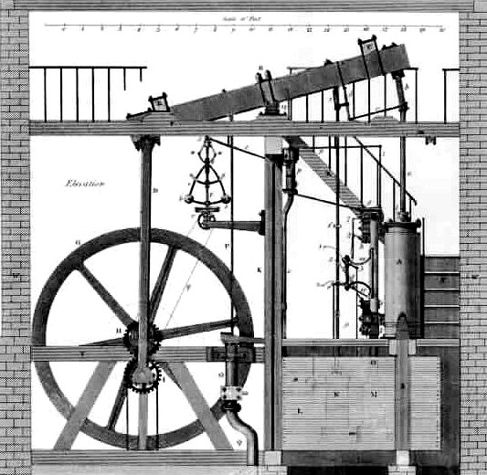
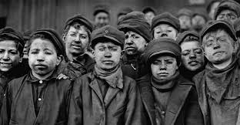
The Industrial Revolution in Britain
1750-1850

Slide 2
The Industrial Revolution
A revolution is a fundamental change
The American and French Revolutions were big changes in government.
The Industrial Revolution was a big shift in how we make things and how our society is powered.
We went from making products by hand at home to making goods in factories with machines
We went from human and animal muscle to using steam, coal, oil, and electricity to power our machines.
The Industrial Revolution, which began in Britain, fundamentally changed the way we work and live.

Slide 3
Pre industrial society
Before the Industrial Revolution most people lived in villages
Work was done by hand
People raised their own food and made their own clothing
Animals were used for the hard jobs like plowing

Slide 4
Changes in Farming
Improvements in farming led to increased food production.
Farmers learned to rotate crops so they didn’t wear out the soil.
Jethro Tull invented the seed drill, so that farmers could plant in rows and not spread seeds all around

Slide 5
The Enclosure Movement
In England rich landowners took over land to raise sheep.
Wool fueled the British textile industry.
Peasants lost their land and moved to the growing cities, serving as a work force for factories

Slide 6
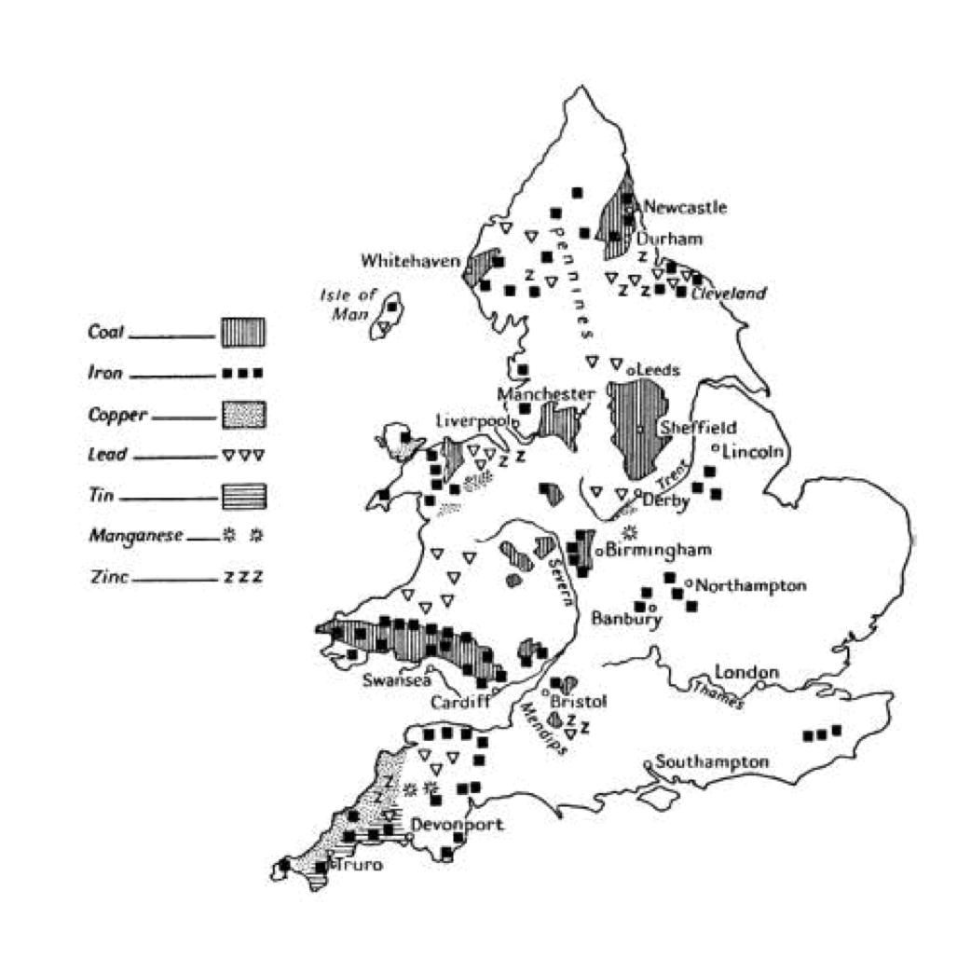
Britain Leads the Way
Britain was the first nation to industrialize.
It had lots of natural resources, including fuels like coal
As an island it has access to the sea for trade.
It had lots of rivers for transportation

Slide 7
New Inventions
In the 1700’s there were several important inventions.
Thomas Newcomen and James Watt invented the steam engine
This new invention was used to run factories and improve trains and ships in the 19th century

Slide 8
Textile Innovations
Before the Industrial revolution most cloth was made from wool or cotton in people’s homes.
This was called the cottage system or putting out system.
New textile machines like the flying shuttle, spinning jenny, and water frame helped produce much more cloth in less time.

Slide 9
First Factories
The first factories in England were built near rivers, powered by water.
The steam engine soon was used to keep machines moving.
Large number of workers could produce goods much more quickly with the factory system
Mass produced goods were cheaper.

Slide 10
Transportation Improvements
Roads and canals helped businessmen get goods to market.
Improvements in transportation, like George Stephenson’s steam train, made moving people and goods much faster than a horse drawn cart.

Slide 11
Urbanization
Changes in farming meant fewer people were needed to produce crops.
Many peasants moved to the cities to work in the new factories.
Urbanization is the growth of cities.
Britain’s cities were noisy, crowded, dirty and busy places.

Slide 12
The Industrial Middle Class
The successful businessmen of Britain were called entrepreneurs, capitalists, or the bourgeoisie.
They earned their living from the profits of their factories.
This new middle class could afford nice houses, clothing, and luxuries.

Slide 13
The Industrial Working Class
Factory workers in English cities worked long hours for low pay.
They lived in crowded buildings called tenements.
Working class neighborhoods were often unsanitary slums.

Slide 14
Mine workers
The industrial revolution increased the demand for coal and iron
English Miners had dangerous and difficult jobs.
Coal dust caused lung diseases and mine cave ins often resulted in death
Men, women, and children mined for coal.

Slide 15
Factory Workers
English factory workers worked shifts 12-16 hours a day, six days a week.
Many women and children were employed in factories and were paid less than men.
Textile machines often maimed workers.

Slide 16
Adam Smith’s Capitalism
Adam Smith was a Scottish economist
He wrote, The Wealth of Nations, in 1776
He argued that the competition of the free market led to more goods at lower costs
He opposed government regulation of business
He believed capitalism would lead to increased prosperity for all

Slide 17
Utilitarianism
Jeremy Bentham and John Stuart Mill supported individual freedom and the free market
However, they wanted government to provide help for the poor and expanded voting rights
Their philosophy was called utilitarianism and emphasized doing the greatest good for the greatest number of people

Slide 18
Karl Marx and Communism
Karl Marx believed that capitalists exploited the industrial workers for profit
The only solution would be for the workers to overthrow the capitalism with a revolution
The new worker’s government would build an equal society, which Marx called communism.

Slide 19
Industrialization Spreads
The inventions and changes in Britain spread to Europe and the US
This second industrial revolution began in the 1850’s and lasted until about 1920.

Slide 20
Steel
Steel was essential to industrialization and was used for train tracks, bridges, and sky scrapers
The Bessemer process made steel stronger and less expensive
US business man Andrew Carnegie made millions on steel.

Slide 21
Electricity
Electricity made many inventions possible.
American inventor Thomas Edison created the light bulb, the battery, and motion pictures.
Homes and cities could be lighted

Slide 22
Transportation Improves
After the the train, the first cars were built
US industrialist Henry Ford mass produced cars, making them affordable.
The first airplane was invented and flown by the Wright Brothers in 1903

Slide 23
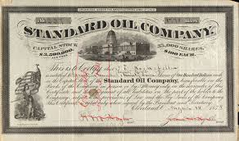
The Rise of Big Business
Along with industrialization came the growth of businesses.
Businessmen sold stock to finance their expansion.
A stock is piece of paper represented a portion of ownership in a company.

Slide 24
Monopolies
Some corporations became monopolies, taking over an entire industry.
People feared that these companies were so powerful they could set prices.
For example, John Rockefeller’s Standard Oil took over almost the entire oil industry in the US.

Slide 25
Captains of Industry or Robber Barons?
People were divided over Big Business.
Some praised corporations for providing jobs, goods, and services to the public.
Others feared that Big businesses unfairly crushed their competition, exploited workers and had too much influence in government.

Slide 26
Source: Ehrhardt, Samuel, Puck Magazine, 1889.
Caption: History Repeats Itself – The Robber Barons of the Middle Ages and the Robber Barons of Today

Slide 27
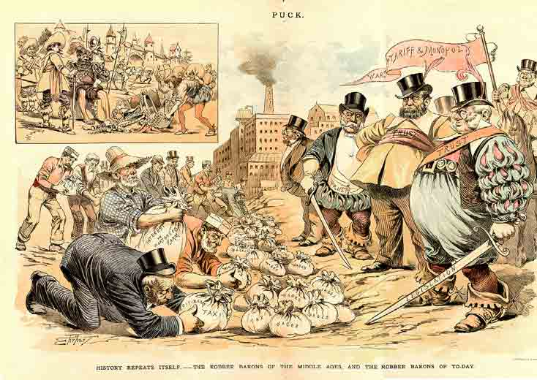

Slide 28
Using Visuals for Evidence
Where possible cite the author and title of the photo, painting, or political cartoon.
Give readers a quick description of the visual resource.
Include the text source citation in parenthesis.

Slide 29
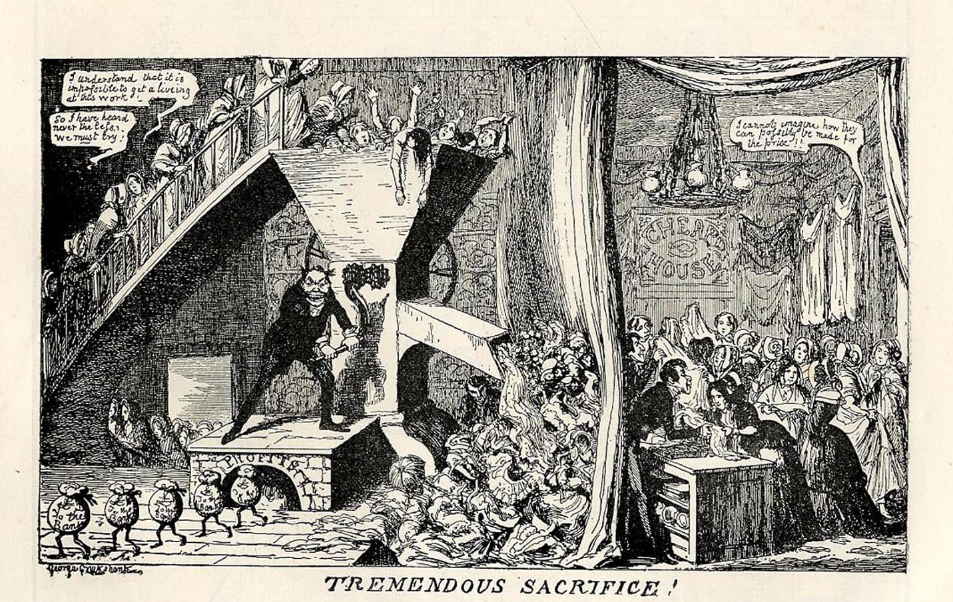

Slide 30
Health Improvements
Sewer systems beneath cities improved public sanitation
Germ theory helped scientists like Louis Pasteur understand link between germs and disease
Hospital care improved with sterilization of surgery instruments

Slide 31
Labor Unions Push for Reforms
Workers organizations called unions formed in industrial countries.
Unions pushed for shorter working hours, better pay, safer working conditions, and the end to child labor.
These efforts led to an increased standard of living for unionized workers

Slide 32
Women Win the Right to Vote
During the 19th century women could not vote in most countries.
Women In England and the United States created a suffrage movement for women to vote.
The movements were successful and women won the right to vote in 1920 in the US and 1928 in England.

Slide 33
Theory of Evolution
Charles Darwin was a naturalist who studied species of animals.
He concluded in his book, Origin of the Species, that all forms of life, including humans, evolved (changed) over millions of years.
He argued the idea of natural selection, where life forms best adapted to their environment survive.

Slide 34
Controversy Over Evolution
Some people opposed Darwin’s theory because they felt it contradicted the Bible.
Religious critics cited the Bible’s book of Genesis, in which God created the world in 7 days.
Nor did they believe humans evolved from apes or that the world was millions of years old.

Slide 35
Fact vs Faith
Scientists supporting Darwin showed evidence of changes in human skeletons.
Geologists provided evidence of the age of the earth by carbon dating.
Religious opponents put their faith in their religious teachings.

Slide 36
Public Education
In the late 19th century reformers won free public education for all children.
By 1881 school was compulsory in England for children 5 -10 years old.
Secondary schools or high schools also expanded.
By the mid 20th century most young people went to schools, rather than work.

